Slide 1

UX in Model-Driven Apps
the good, the bad and the ugly

Slide 2

Power apps vs ux & ui
UX & UI
User Experience: user’s journey to solve a problem (experience using the app).
User Interface: what the user sees when the solving the problem (visuals on the app).
Canvas Apps
Model-Driven Apps
Blank canvas
Drag-and-drop interface & PowerFx
Full control & freedom over the layout and design
Highly customisable User Experience
Data less important than in MDAs
Data model-centric
Forms, views, charts, and dashboards to interact with data
Standardised user interface with limited control
What about UX?

Slide 3
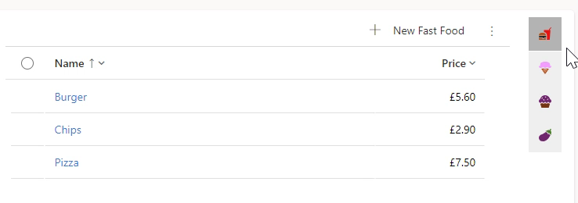
Saddle Up Your Forms
The Good
Tabs
First tab vs subsequent tabs
Data placed on the tabs to align with user needs
Multi-section tabs as opposed to multi-column sections - the form reflow behaviour works better
Consistent tab structure:
Complex forms 3-column tabs
Simple: 2-column tabs
Sections
Logical data grouping
Visual hierarchy
Fields into sections
Order of importance
Field Names Format
Consistency across field names format
Sentence style
Capistalise Each Word
Apply to all the tables and forms
Forms - General
Use Tooltips
Use business rules
Custom forms vs. out-of-the-box
Collaboration with users
Reference Panel
The Bad
The Ugly
The Good

Slide 4
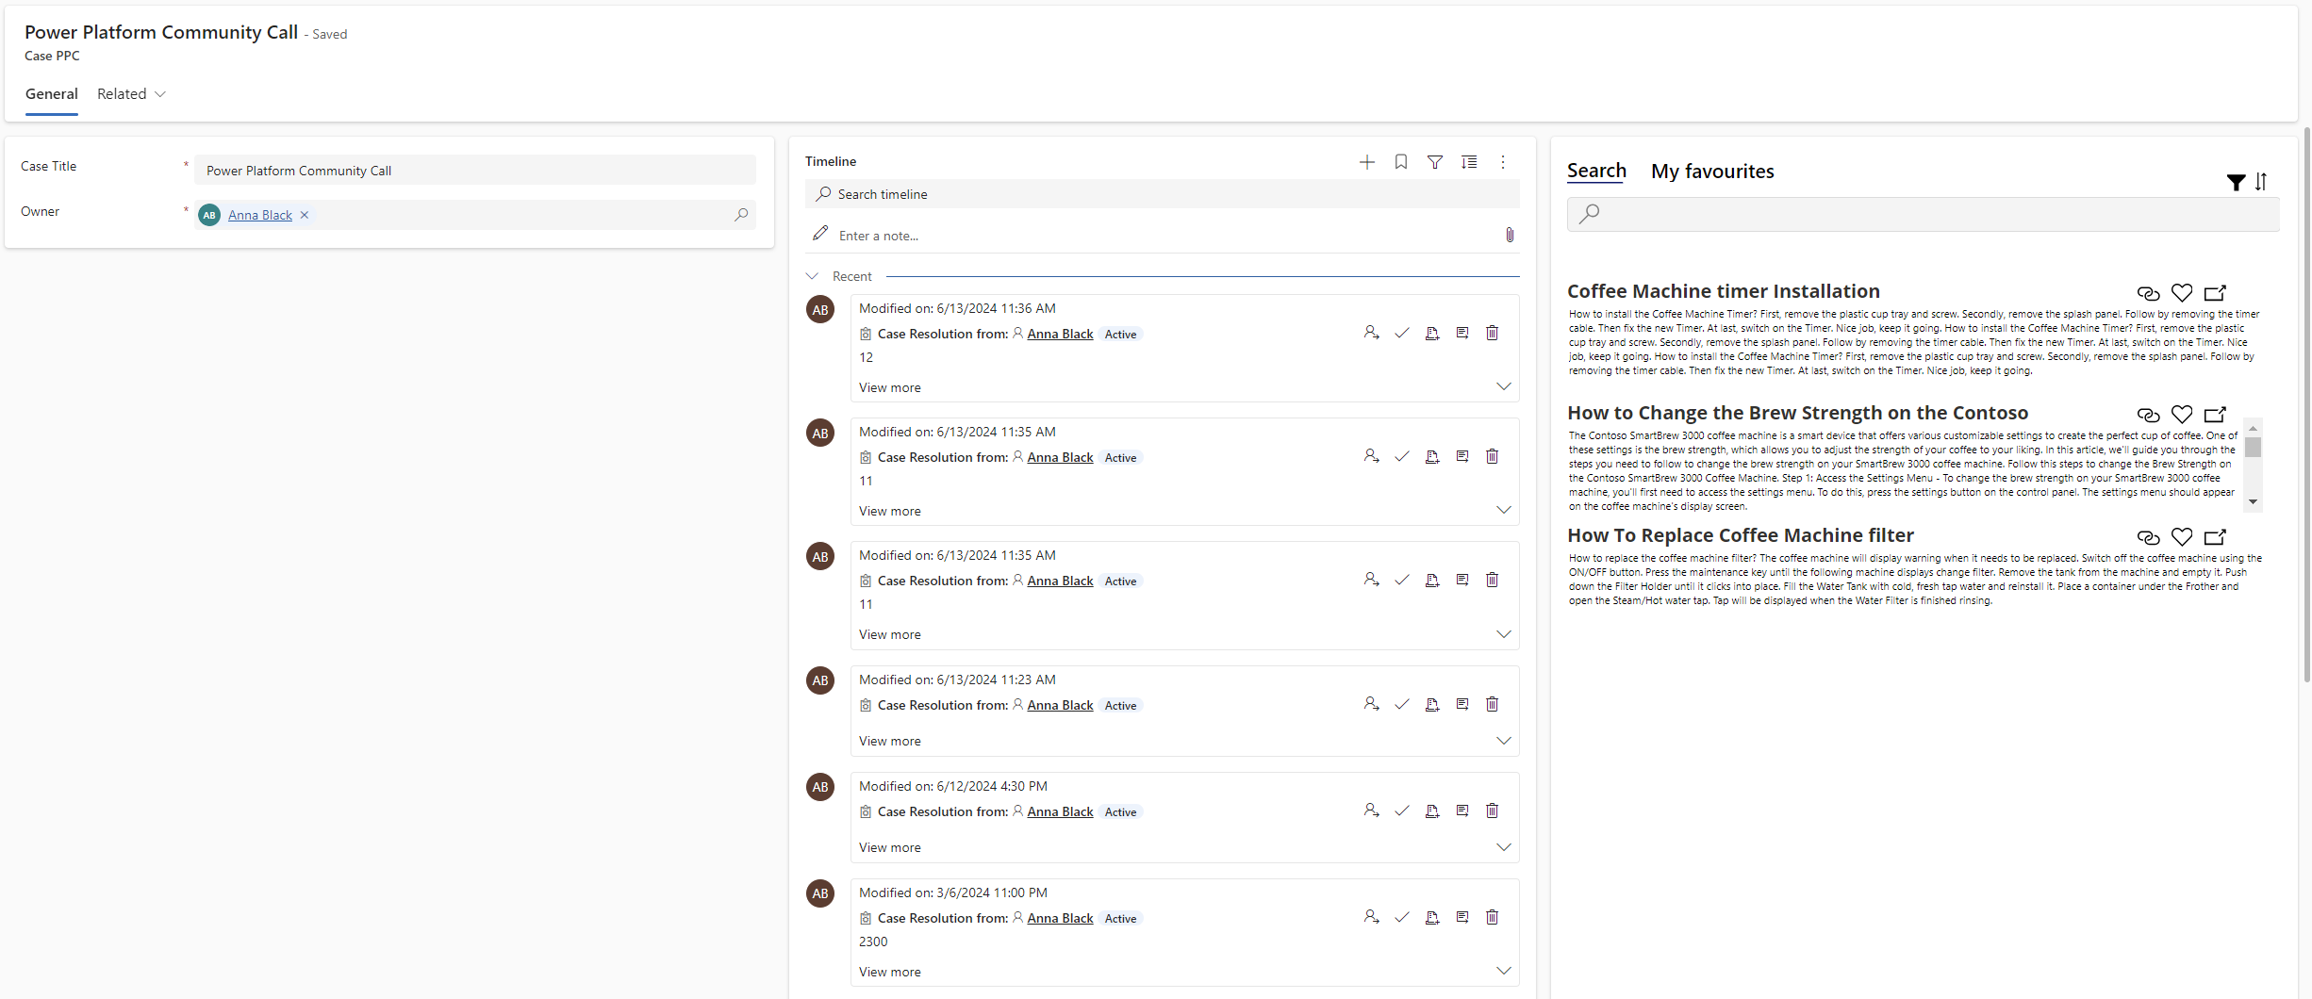
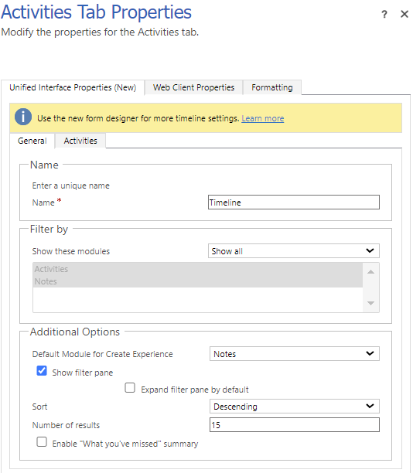
Saddle Up Your Forms
The Good
The Bad
Overload of data-driven controls on the default tab
Quick view form, Subgrids, Timeline and Assistant
Cause the most strain on form responsiveness and loading speed.
Mixed form layouts
Lack of consistency on the forms across the tables
Timeline or Widgets place randomly
Timeline size
No familiar patterns
Users force to look for the information
Multiple subgrids
Extensive scrolling instead of a Reference Panel
Overcomplicated Business Process Flows
Multiple fields repeated on the form and BPF
Misuse - aimed to visualise the process and guide users, not for populating data.
The Ugly
Unused whitespace and Timeline scrolling
10
Tip: Adjust number of records displayed on the Timelines via classic interface
The Good
The Bad

Slide 5
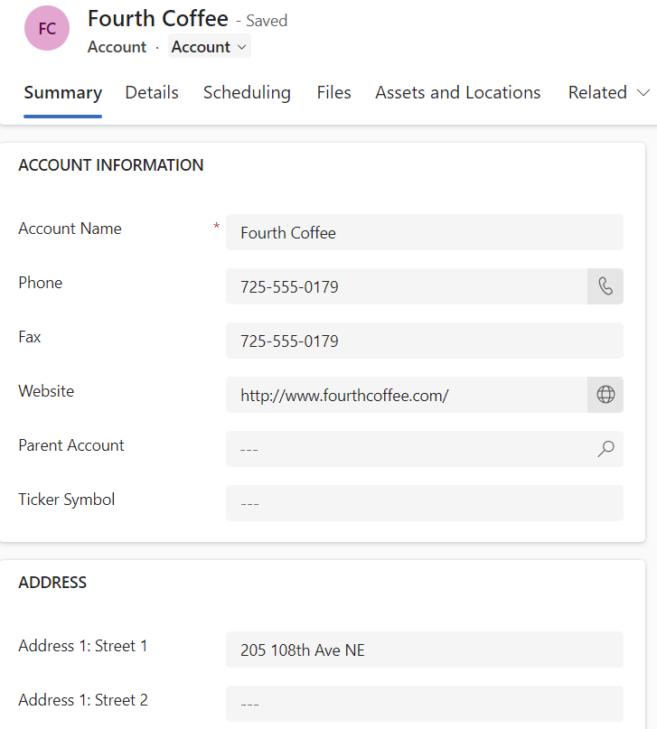
Saddle Up Your Forms
The Bad
The Ugly
The “Related” tab
Not updated, long list of relationships
Can cause confusion
Use the classic interface to update
De-duplicate – if already on a form, remove
Section names
Using the OOTB CAPITALISED
Difficult to read and scan for information
Required fields
If span across different tabs, difficult to find and populate
Can show errors when saving
Discouraging to fill out
Use Quick create forms - initial record creation with min data
Legacy systems
Forms re-built with unused fields
Lost opportunity to improve UX
The Good
Tip: use the XrmToolBox Easy Translator to update
The Bad

Slide 6
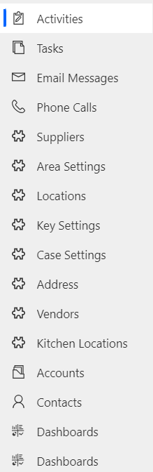
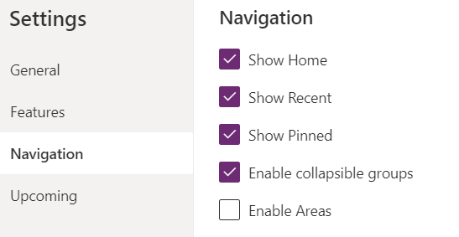
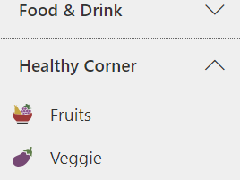
Navigating the Wild West
The Good
The Bad
Hidden unnecessary elements
Sitemap organised into logical areas
Groups within the area to easily scan through the navigation
Collapsible groups enabled
Quick access to frequently used tables & dashboards
Use of URLs – access to other apps
Ungrouped and lengthy navigation
Use of a single area only
Excessive scrolling can frustrate users.
Lack of well-structured sitemap and no alignment with the user needs
The Ugly
Lack of quick access to the key tables
Navigation through other tables or Advanced Find to find a record
Enable collapsible groups
The Bad

Slide 7
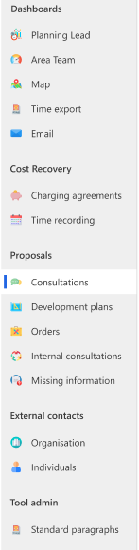




Icons: Symbols of Digital Range
The Good
The Bad
Enhance visual appeal of the UI
Custom table icons updated
Use colour icons
Brand consistency
NB: Custom icons currently do not work with “New Look”
Mixing different styles of icons (color and monochrome)
Mix of empty & filled icons
Yes
No
The Ugly
Using the default "puzzle" icons
User cannot benefit from the collapsible navigation
The Good

Slide 8
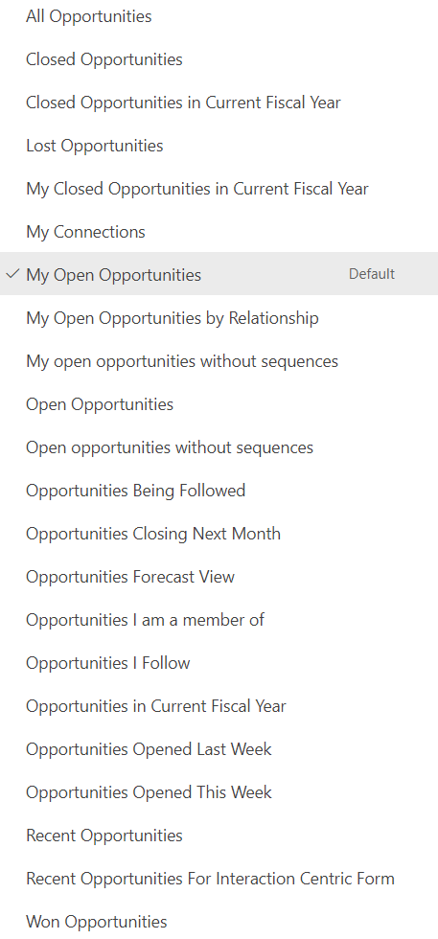
Views from the Saloon
The Good
The Bad
Efficient navigation to access key data
Short, self-explanatory view names
Familiarity & harmony - consistent column ordering
Charts for enhanced filtering capabilities
Dashboards with views
View selector
Number records per page
Numbering views
Lack of system views
Unnecessary columns:
“Active” views with status
“My” views with the owner
Dashboards with irrelevant views
Views not updated on the forms
The Ugly
Overloaded views with long, descriptive names
Inconsistent column ordering,
Overload of OOTB view
Numerous columns that require excessive scrolling
Lack of charts.
The Ugly

Slide 9



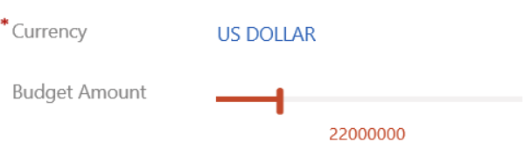
PCFs (Pioneering Custom Frontier-ization)
The Good
The Bad
Bespoke components that enhance UX
Improved data visualisation, time controllers, auto-complete & more
Used across forms, views, dashboards
Cohesive and engaging interface
Too many PCFs can slow down the app
Not properly selected PCF
Aesthetic-Usability Effect:
phenomenon where users perceive aesthetically pleasing designs as more usable.
The Ugly
Inconsistent, mixed UI creating a disjointed user experience.
Using PCFs without support
Slide control PCF

Slide 10
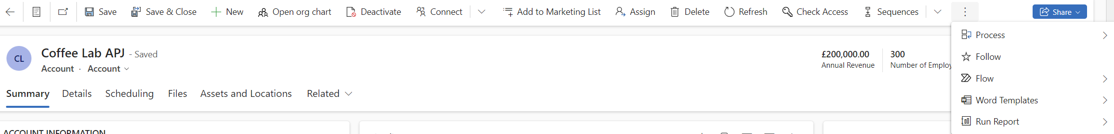
Command Bars: Taming the Unruly
The Good
The Bad
The Ugly
Optimised Command Bar
Unused options are hidden
Ribbon Workbench to fine-tune the layout
Clutter-free and intuitive interface
Custom buttons without clear visual cues
Confusing labels
New button added to a form, not to a view for a specific table
Overflown Command Bars with crucial options hidden under the ellipsis menu
Unnecessary elements occupy prime real estate
Lack of consistency in the command bars when adding new ones
The Ugly - Overflown Command Bars

Slide 11
Guarding the Gold: Security Roles
The Good
Strategically leveraging security roles to refine the UX
Unique forms and views for specific teams
Simplifying the interface without the need for multiple apps
The Ugly
Relying solely on the native Dynamics 365 apps and out-of-the-box roles
Overwhelmed users by unnecessary features they don't need
1
2
3
The Bad
Multiple versions of the same forms
Views created for a specific team, visible to everyone
Security roles not updated during enhancements, e.g. BPF

Slide 12
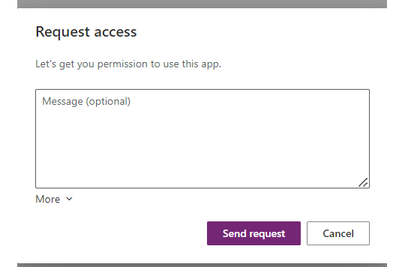
Canvas Apps: Open Range Crafts
1
The Good
Embed Canvas Apps to enrich the experience with improved search, record creation, data integration, and more.
Harmonious visual integration and seamless transitions.
2
The Bad
Multiple Canvas Apps with different looks and feel – disjointed UX
Potential exposure to question the differences - between the canvas apps, and between the MDA and canvas apps.
The Ugly
2
The Ugly
Embedding inaccessible apps causes errors.

Slide 13
Cowb-AI Code: Enhancing the UX
1
The Good
2
The Caution
Leveraging AI-powered features, such as generated summaries, process guidance, and intelligent suggestions
Subtle UX enhancement with AI
Providing valuable support without being overbearing or disruptive
Excessive reliance on AI powered feature can lead to poor UX
Poor integration
Creating confusing and overwhelming user experience
Lack of balance
Complement not complicate

Slide 14
THE END

